Slide 1
CraCKING THE CODING INTERVIEW
A Brief Summary of Questions

Slide 2
Chapter 3:
Stacks and queues

Slide 3
Stack MIN: Efficiently tracking minimum element

Slide 4
Stack MIN: Efficiently tracking minimum element
-All the operations Push, Pop or Min run in O(1) time

Slide 5
Clarifications
STACK MIN
Are there any limitations on the number of elements?
How should the stack behave if its empty and we can min or pop?
Can we assume all the elements are unique or do we need to handle duplicates?

Slide 6
Solution 1#: Node level tracking
STACK MIN

Slide 7
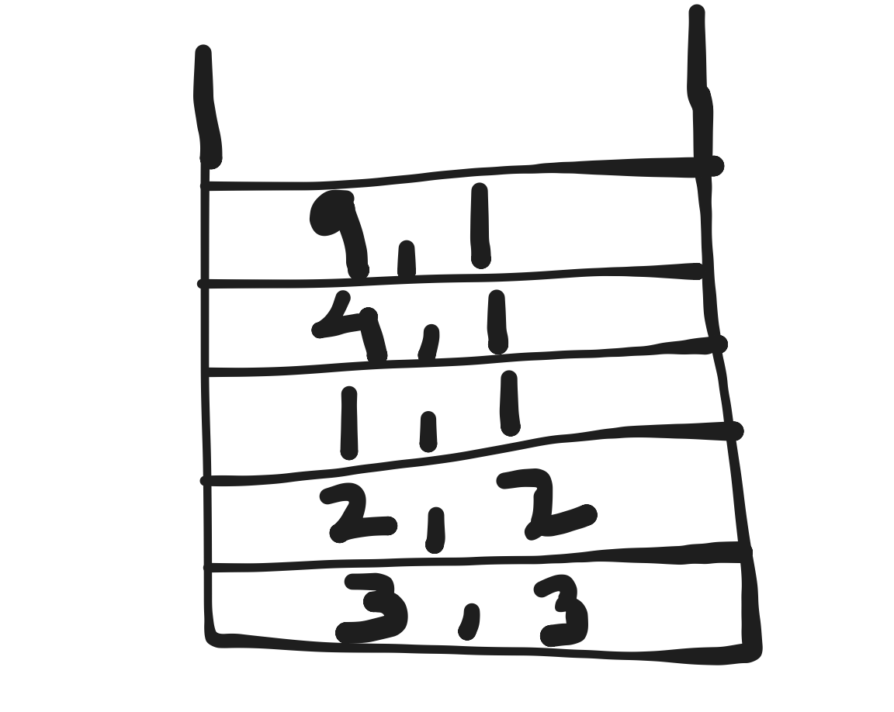
STACK MIN
TC = O(1)

Slide 8
Solution 2#: Additional Stack for mins
STACK MIN

Slide 9
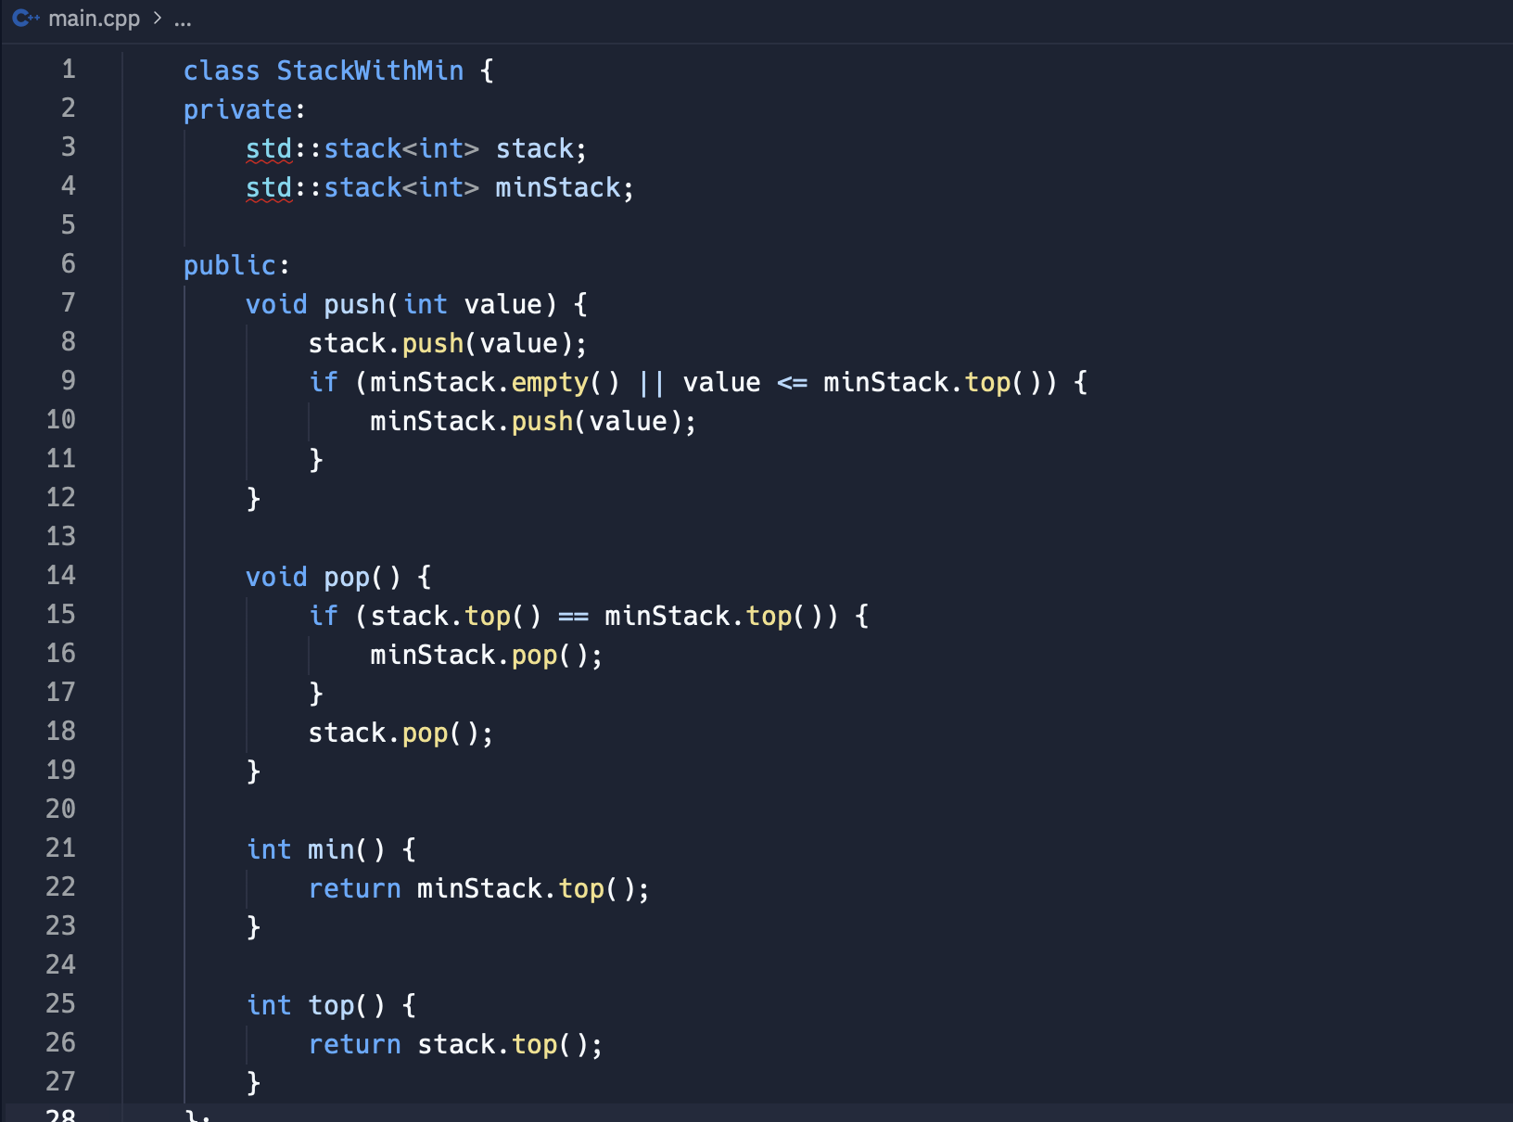
STACK MIN
TC = O(1)
SC = O(n)

Slide 11
STACK OF PLATES: DEsigning setofstacks

Slide 12
Clarifications
STACK OF PLATES
POPAT(index) is called at an index that doesn’t exists?
Should we handle very large stacks differently?
How should the SetOfStacks behave if the capacity is set to a very large or small value?

Slide 13
Implementing push() and pop() functions
STACK OF PLATES

Slide 14
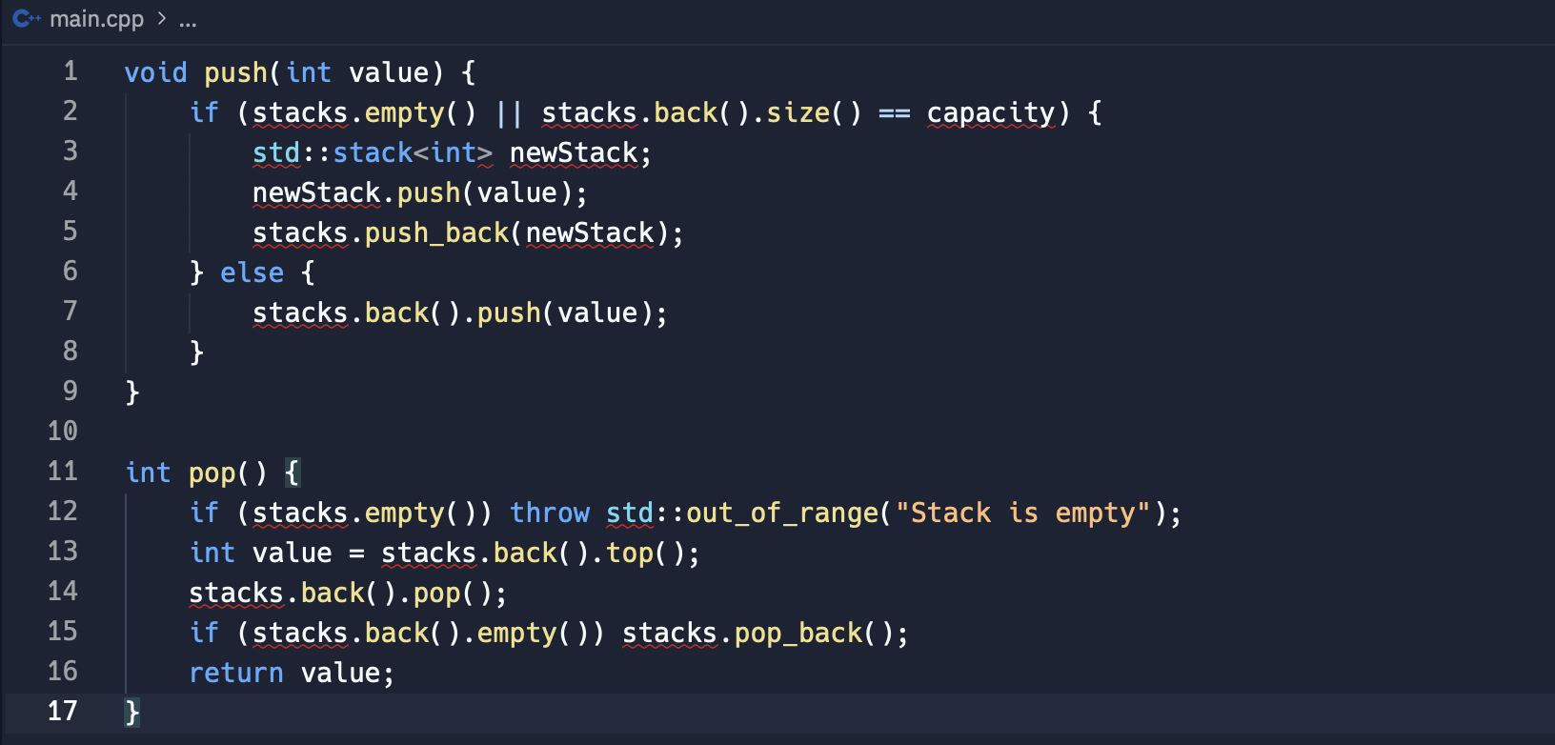
STACK OF PLATES
Code
TC = O(1)

Slide 15
Follow up: Implementing POPAT(index) function
STACK OF PLATES

Slide 16
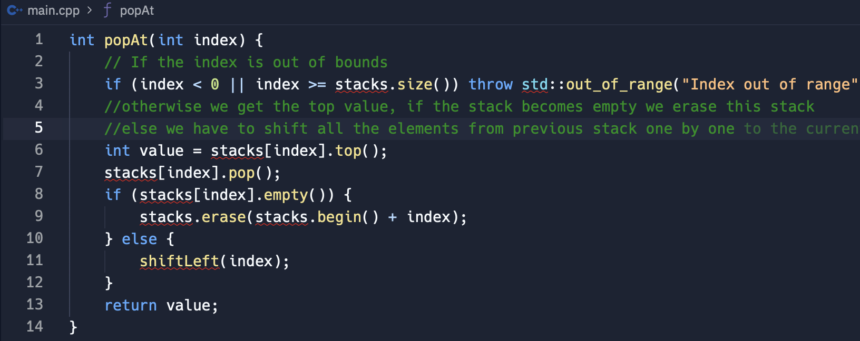
STACK OF PLATES
Code
TC = O(n), due to rollover system

Slide 17
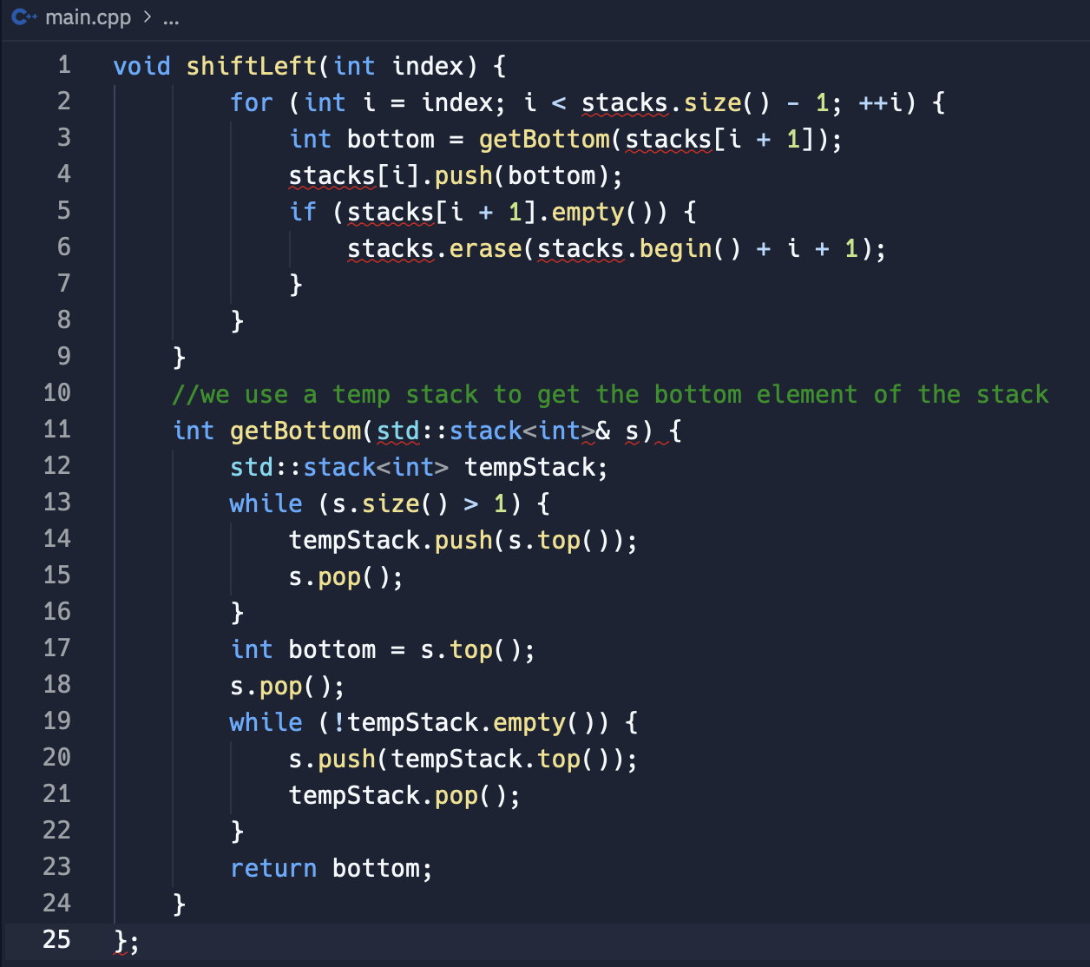
STACK OF PLATES
Code
TC = O(n), due to rollover system

Slide 18
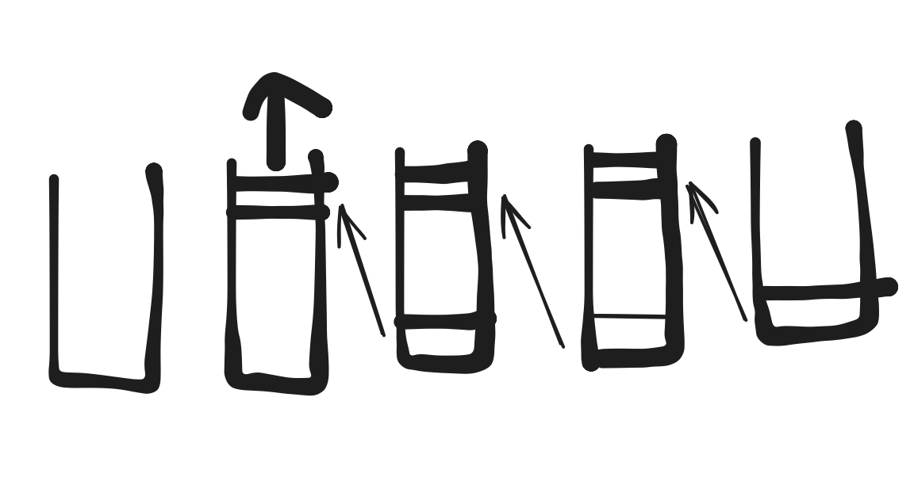
STACK OF PLATES

Slide 20
Queue via stacks: implementing myqueue class

Slide 21
Clarifications
QUEUE VIA STACKS
Constraints regarding the size of queue or the type of elements it should hold?
Dequeue or peek on an empty queue
Expected performance?

Slide 22
Solution 1#: basic dequeue operation
QUEUE VIA STACKS

Slide 23
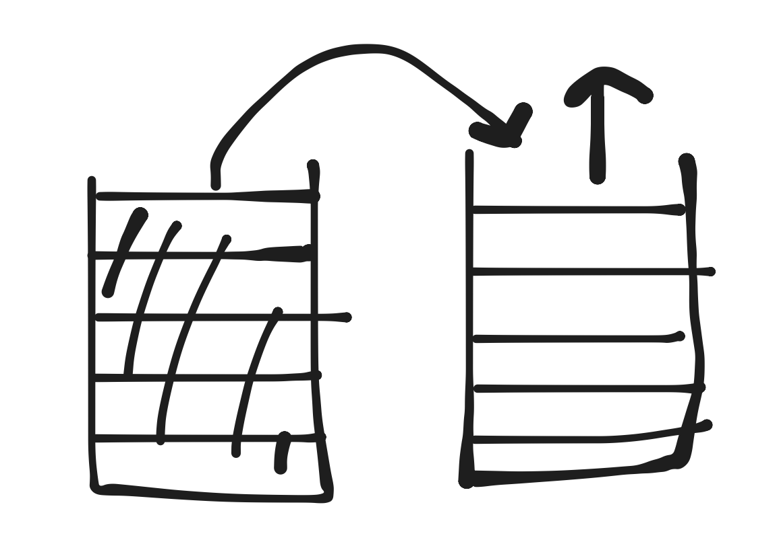
QUEUE VIA STACKS
Stack 1
Stack 2

Slide 24
Optimal approach#: efficient dequeue operation
QUEUE VIA STACKS

Slide 25
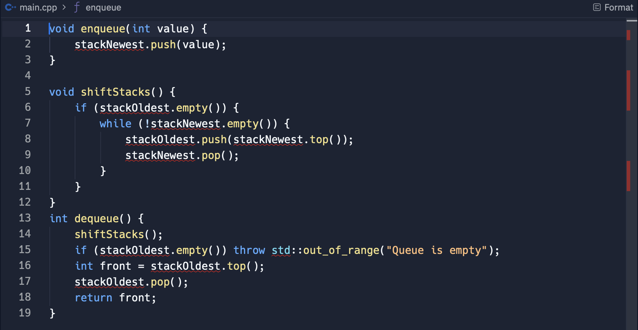
QUEUE VIA STACKS
Code
TC = O(1)

Slide 27
SORT STACK: Sorting a stack with a temporary stack

Slide 28
Clarifications
SORT STACK
What are the constraints on the stack size?
Should we handle duplicate elements in any specific way?
Is there a need to optimize space usage further?

Slide 29
Solution 1#: Using three stacks
SORT STACK

Slide 30
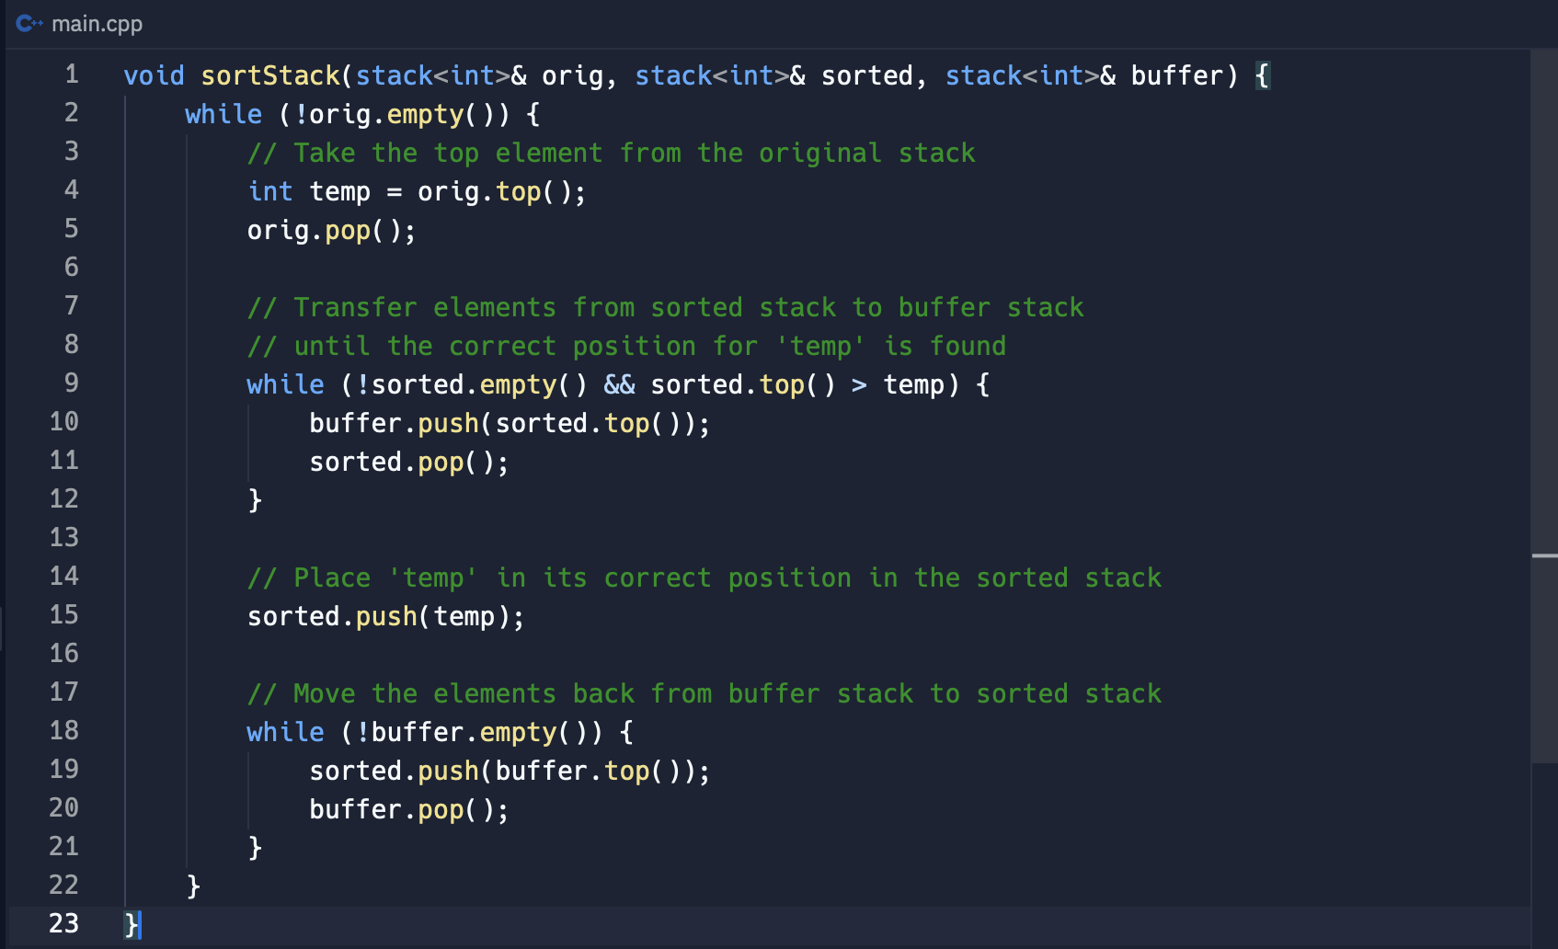
SORT STACK
TC = O(n^2)

Slide 31
Solution 2#: Using two stacks
SORT STACK

Slide 32
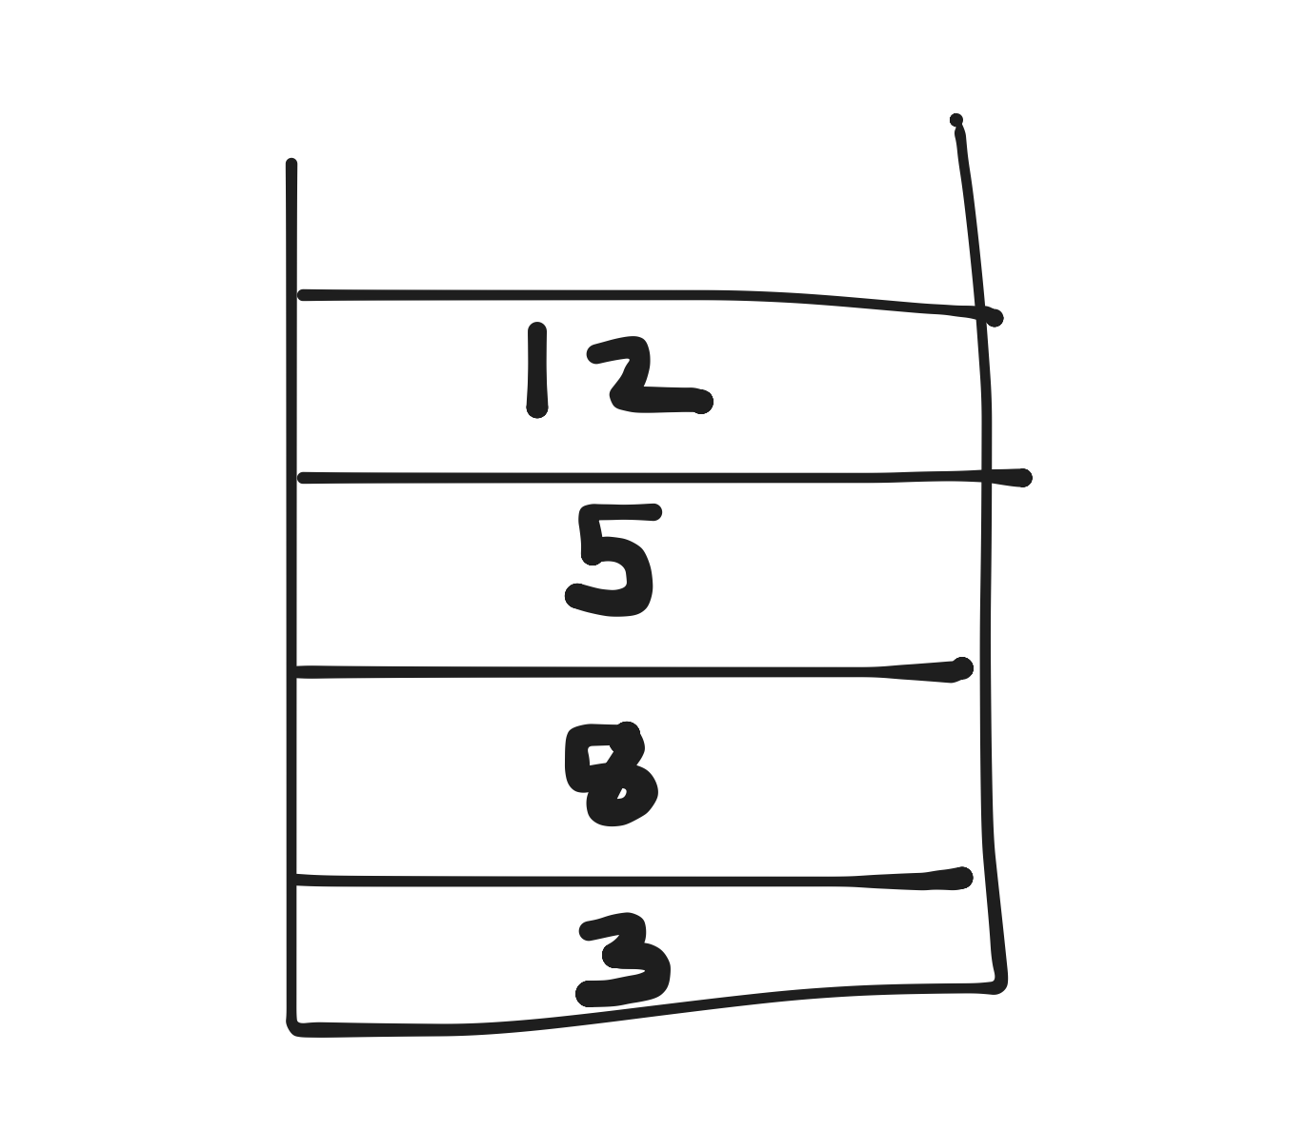
Example
SORT STACK
Step 1: Pop 12 from s1 and push it into s2.
Step 2: Pop 5 from s1
Step 3: Push 12 back onto s2.
Step 4: Continue with remaining elements

Slide 33
SORT STACK
TC = O(n^2)

Slide 35
Animal Shelter: Implementing a fifo system for dogs and cats

Slide 36
Solution approach
ANIMAL SHELTER

Slide 37
Solution approach
ANIMAL SHELTER
Use separate stacks for cats and dogs

Slide 38
Step by step explanation
ANIMAL SHELTER
Enqueue, dequeueAny, dequeueDog, dequeueCat

Slide 39
Step 1: Enqueue Operation
ANIMAL SHELTER

Slide 40
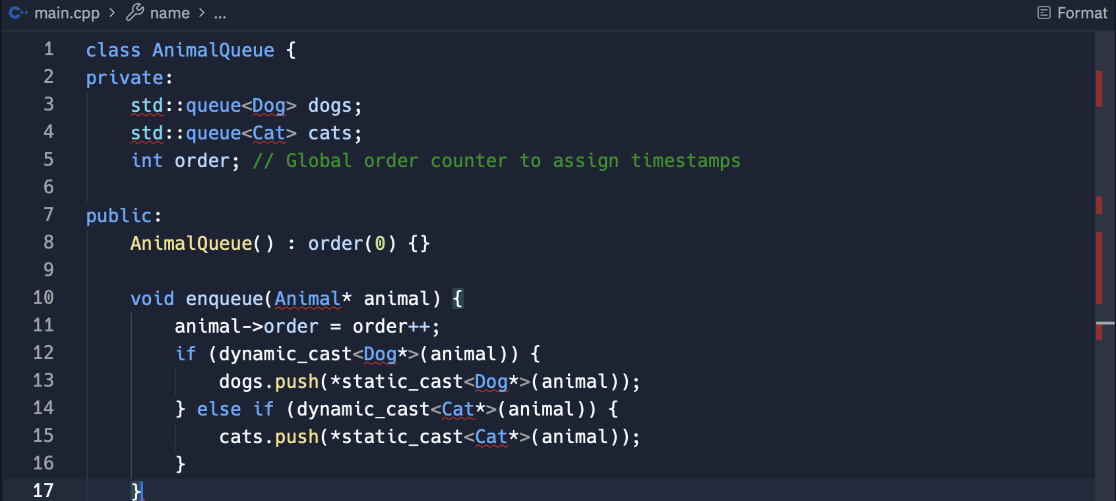
ANIMAL SHELTER
TC = O(1)

Slide 41
STEp 2: animal queue class
ANIMAL SHELTER

Slide 42
ANIMAL SHELTER
TC = O(1)

Slide 43
STEp 3: DEqueue operations
ANIMAL SHELTER

Slide 44
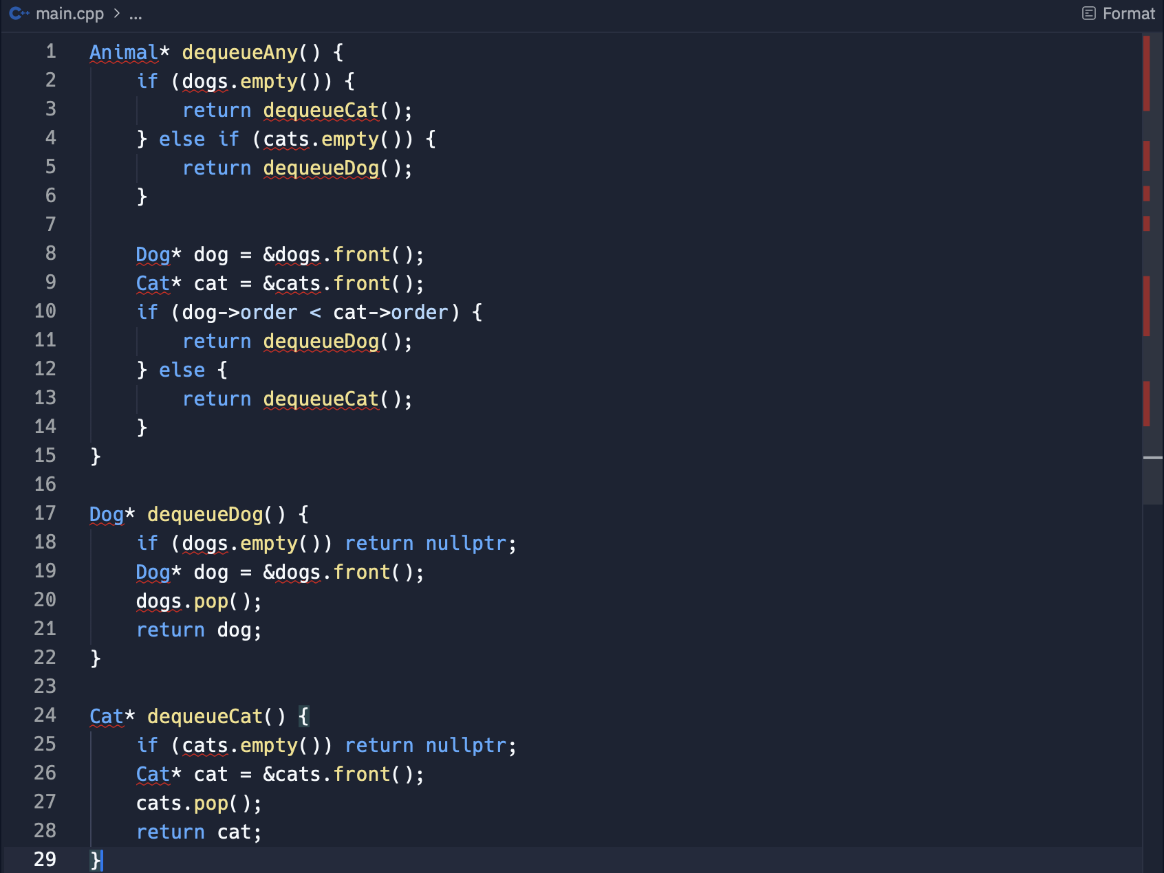
ANIMAL SHELTER
TC = O(1)

Slide 46
Three in one: implementing three stacks using a single array

Slide 47
Clarifications
THREE IN ONE
How should we handle the situation if the stacks need to grow beyond the capacity of array?
Are there any specific constraints on the minimum size of array or the number of stacks?
How should we manage the overhead of shifting elements in flexible approach?

Slide 48
Solution 1#: Fixed Division
THREE IN ONE

Slide 49
Solution 1#: Fixed Division
THREE IN ONE
Each stack has its own range:
Stack 1: [0, n/3)
Stack 2: [n/3, 2n/3)
Stack 3: [2n/3, n)

Slide 50
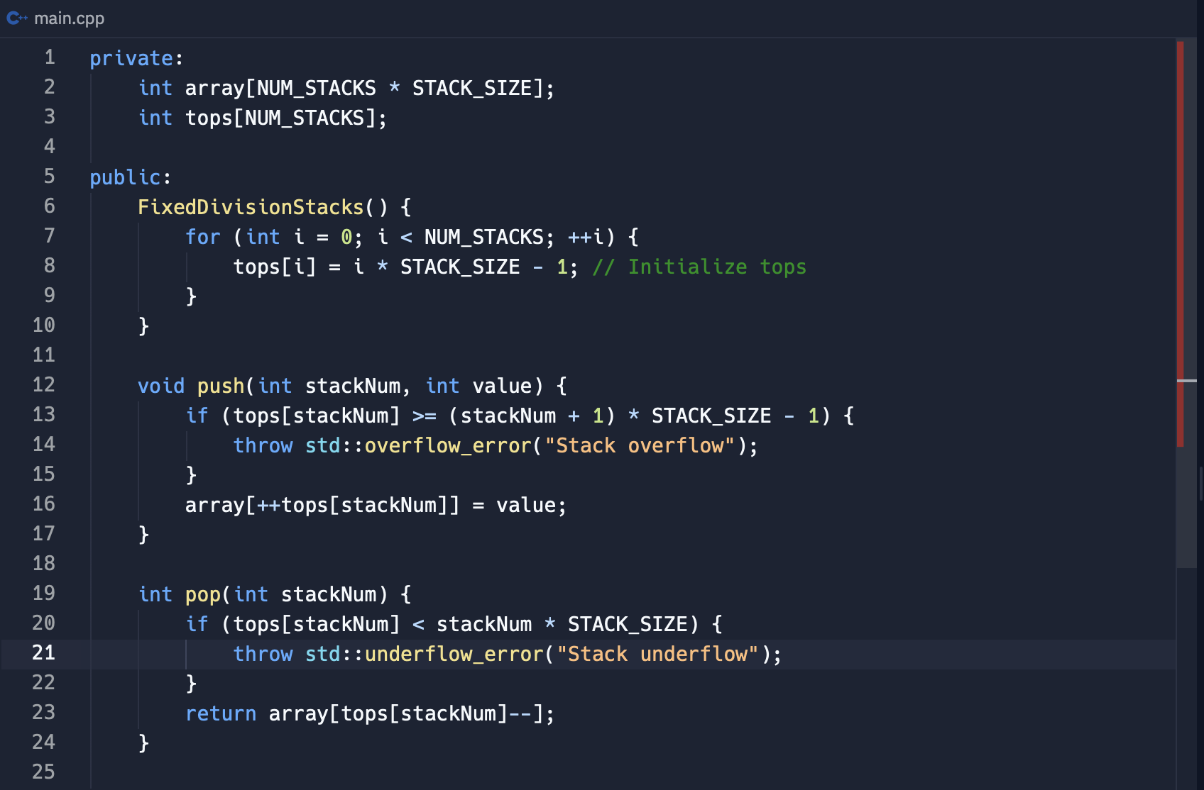
THREE IN ONE
TC = O(1)

Slide 51
Solution 2#: flexible divisions
THREE IN ONE

Slide 52
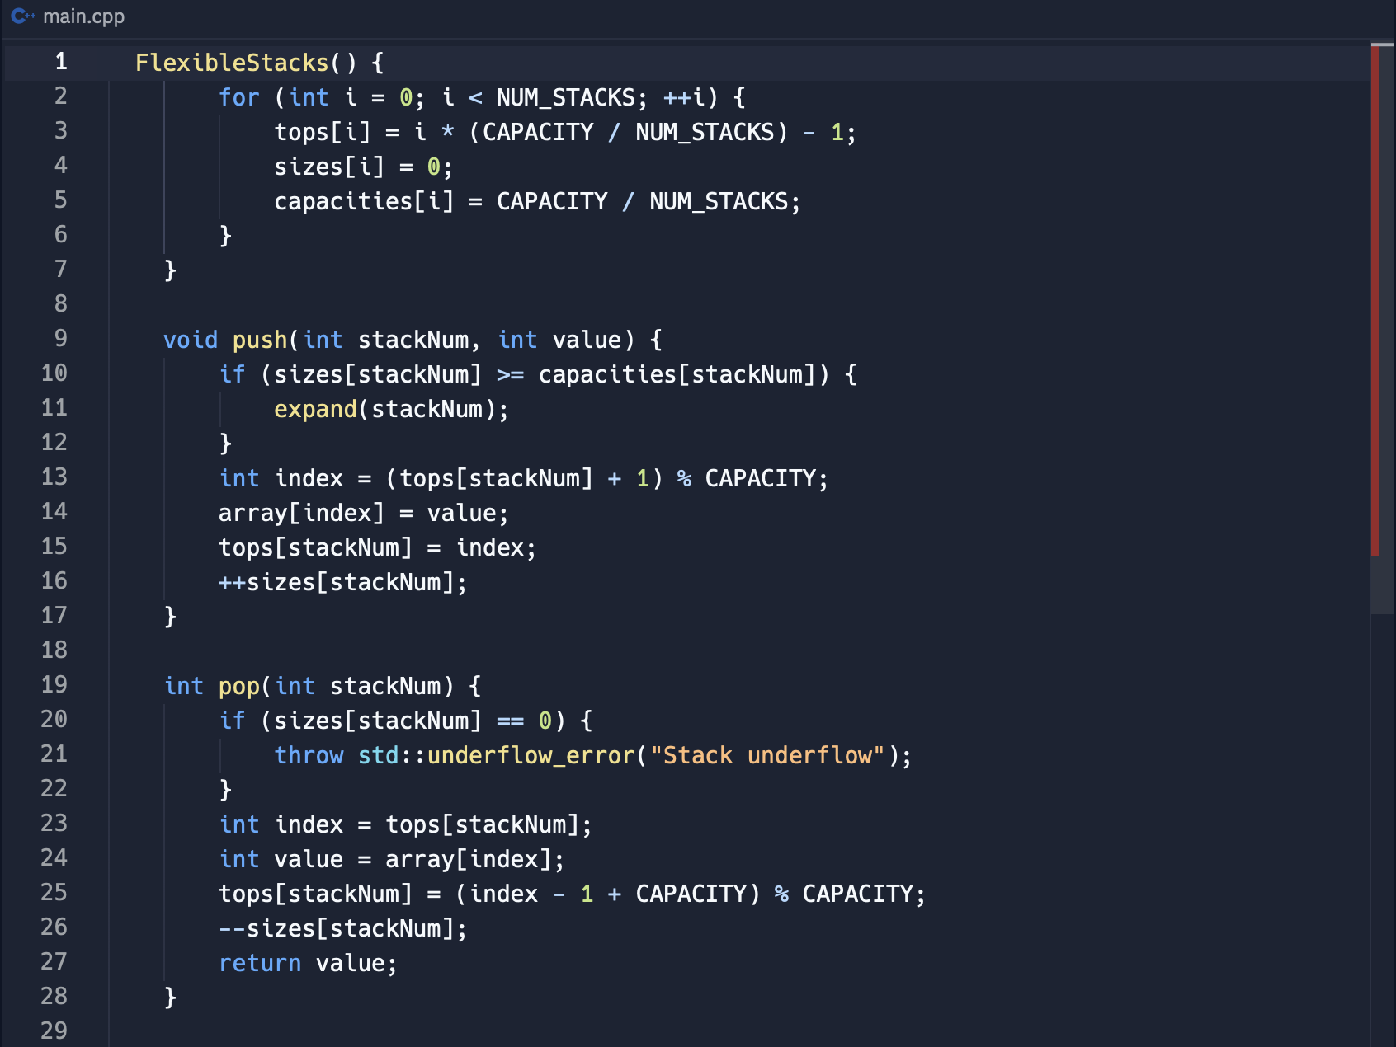
THREE IN ONE
TC = O(n)
SC = O(n)

Slide 53
Remember to always ask clarifying questions before starting your solution.
Always think from a simple solution then build up from it.
Practise and revise as often as possible.

Slide 54
Thank you for watching!

